Slide 1

Academic Session 2025-26
Even Semester Jan-Jun’26
Apex Institute of Technology
Department of Artificial Intelligence and Machine Learning
System Design (23CST-390)
Faculty: (Er.) Kamaljeet Kaur (E19147)
DISCOVER . LEARN . EMPOWER
Lecture
Databases in System Design

Slide 2
Learning Objectives
Understand the fundamental concepts of system design and its importance in building
scalable applications.
Learn the principles of scalability, availability, and reliability in large systems.
Differentiate between Monolithic and Microservices architectures.
Explain key performance metrics such as latency and throughput.
Understand how caching improves system speed and reduces load on backend services.

Slide 3
Course Outcomes
On completion of this course, the students shall be able to:-
CO1 | Understand the fundamental system design principles, including scalability, high availability, and fault tolerance, while analyzing how these core principles influence architectural decisions in real-world distributed environments.
CO2 | Apply various distributed architectural patterns, key database models (SQL and NoSQL), and critical communication protocols to evaluate their specific applications and trade-offs in modern system designs.
CO3 | Apply advanced scaling techniques, such as caching, load balancing, database sharding, and replication, to design system components that effectively handle massive user traffic and data volumes.
CO4 | Analyze the trade-offs between different system architectures, data storage solutions, and consistency models (like the CAP theorem) to select and justify optimized configurations for performance, cost, and reliability goals.
CO5 | Create and document comprehensive, end-to-end system designs that are inherently scalable, distributed, and fault-tolerant, leveraging modern paradigms such as cloud computing and microservices architecture.

Slide 4
Unit-1 Syllabus
Unit-1 | System Design
Introduction to System Design | Introduction to System Design, Functional & Non-Functional Requirements, Scaling Challenges, Load Balancing, Caching Strategies, Replication, Sharding.
Databases in System Design | Databases in System Design – SQL vs NoSQL, CAP Theorem, Distributed Databases, Consistency Models, Eventual Consistency, Distributed Caching (Redis, Memcached), High Availability, Fault Tolerance, Microservices vs Monolithic Architecture.

Slide 5
Topic to be Covered
      CAP Theorem
CAP Theorem Components
Availability
Partition Tolerance
Key-Value Stores
CAP Trade-Offs
CA Systems: Consistency + Availability
CP Systems: Consistency + Partition Tolerance
AP Systems: Availability + Partition Tolerance

Slide 6
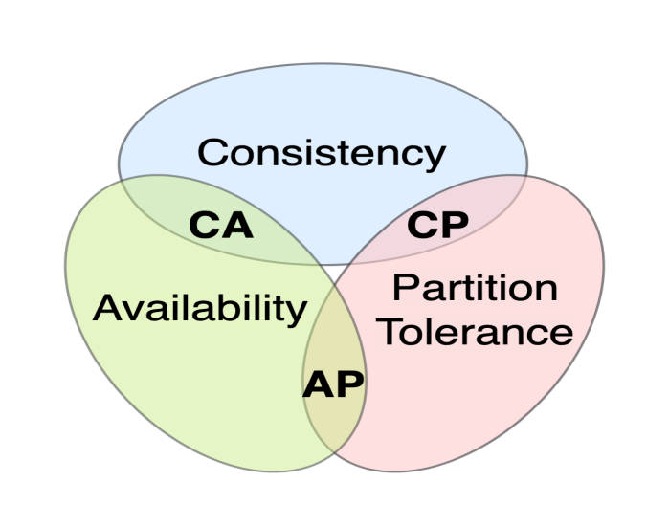
Eventual Consistency in CAP Theorem
In a distributed data store, you can only guarantee two of the following three:
Consistency: Every read receives the most recent write.
Availability: Every request receives a response (even if data is stale).
Partition Tolerance: The system works despite network failures.

Slide 7
CAP Theorem Components
9
Consistency : Every read receives the most recent write or an error. All nodes in the system see the same data at the same time. When a write occurs, all subsequent reads must reflect that write across all nodes.
Real-world example: In a banking system, if you transfer ₹10,000, all ATMs must immediately show the updated balance—no delays or inconsistencies allowed.

Slide 8
Availability
Every request receives a response, regardless of the state of any individual node. The system remains operational even if some nodes fail. Non-failing nodes must return reasonable responses within acceptable time.
Real-world example: An e-commerce website remains accessible during peak sales, even if some backend servers are experiencing issues—customers can always browse and purchase.

Slide 9
Partition Tolerance
The system continues to operate despite arbitrary network partitions or message loss between nodes. Network failures won't bring down the entire system. This is non-negotiable in distributed systems.
Real-world example: If the connection between data centres in Mumbai and Bangalore breaks, both locations continue serving users independently until connectivity restores.

Slide 10
CAP Trade-Offs(Con….)
In distributed systems, network partitions are inevitable—cables break, routers fail, and data centres lose connectivity. Since partition tolerance is mandatory, you must choose between consistency and availability during partitions.

Slide 11
CA Systems: Consistency + Availability
Prioritise consistency and availability but cannot tolerate partitions. These systems work well in single-node or tightly coupled environments.
Example: Traditional RDBMS in a single data centre. When the network splits, the system must stop to prevent inconsistencies.

Slide 12
CP Systems: Consistency + Partition Tolerance
Maintain consistency even during network partitions, sacrificing availability. Some nodes may become unavailable to prevent inconsistent data.
Examples: MongoDB (in certain configurations), HBase, Redis Cluster. Best for financial transactions where accuracy is critical.

Slide 13
AP Systems: Availability + Partition Tolerance
Prioritise availability during partitions, accepting eventual consistency. All nodes remain accessible but may serve stale data temporarily.
Examples: Cassandra, DynamoDB, Couchbase. Ideal for social media feeds where slight delays are acceptable.

Slide 14
Summary of the Lecture
CAP Theorem Overview
The CAP Theorem states that a distributed system can guarantee only two out of three properties at the same time: Consistency, Availability, and Partition Tolerance. In real-world distributed systems, network partitions are unavoidable, so systems must choose between consistency and availability.
Meaning of Eventual Consistency
Eventual consistency is a consistency model where all replicas of data do not update immediately after a write operation. Instead, the system guarantees that if no new updates occur, all replicas will eventually converge to the same value over time.
Eventual Consistency in CAP Context
Systems that follow eventual consistency usually choose Availability (A) and Partition Tolerance (P) over strong Consistency (C). During network partitions, the system remains available and continues to accept read and write requests, even if some nodes temporarily return outdated data.

Slide 15
Next Lecture
Distributed Databases and Eventual Consistency
Distributed Caching: Deep Dive into Redis and Memcached
High Availability and Fault Tolerance Mechanisms
Microservices vs. Monolithic Architecture Comparison

Slide 16
Quiz
What does the CAP theorem stand for?
a) Consistency, Accuracy, Performance
b) Consistency, Availability, Partition Tolerance
c) Concurrency, Availability, Performance
d) Consistency, Accessibility, Persistence
Eventual consistency guarantees that:
a) Data is always consistent
b) Data is never consistent
c) Data becomes consistent over time if no new updates occur
d) Data is consistent only during failures
Which CAP properties are chosen by eventually consistent systems?
a) Consistency and Availability
b) Consistency and Partition Tolerance
c) Availability and Partition Tolerance
d) Consistency only

Slide 17
FAQ’s
What is Eventual Consistency?
Eventual consistency is a consistency model in which all replicas of data may not be updated immediately, but they will eventually become consistent if no new updates occur.
Why is Eventual Consistency used in distributed systems?
It is used to improve availability, scalability, and performance, especially in systems spread across multiple nodes or geographic locations.
How does Eventual Consistency relate to the CAP Theorem?
In the CAP theorem, systems using eventual consistency prioritize Availability and Partition Tolerance over strong Consistency.
What are the advantages of Eventual Consistency?
Higher system availability, low latency, fault tolerance, and better scalability in large distributed systems.
What are the limitations of Eventual Consistency?
Temporary data inconsistency and stale reads, making it unsuitable for applications requiring strict real-time accuracy such as banking transactions.

Slide 18
References/ Articles/ Videos
Book Reference:
Kleppmann, Martin
Designing Data-Intensive Applications, O’Reilly Media, 2017.
Tanenbaum, Andrew S., & Van Steen, Maarten
Distributed Systems: Principles and Paradigms, 2nd Edition, Pearson.
Tutorial Link:
https://www.youtube.com/watch?v=BHqjEjzAicA&t=22s
Video Link:
https://www.youtube.com/watch?v=8UryASGBiR4

Slide 19

Class-Wise Feedback

Slide 20
Thank You
For queries Email: kamaljeet.e19147@cumail.in

